Slide 1

1
SRM VALLIAMMAI ENGINEERING COLLEGE (An Autonomous Institution) SRM Nagar, Kattankulathur – 603 203.
1908611 - Mini Project (review 1)
Malicious Web Deception Analysis: An Advanced Machine Learning Framework for secured website
Batch Members
142222205061 – Mahaalaksumy S
142222205067 – Mohammed Nazeem N
142222205085 – Rohith H
142222205087 – Saffiya Simra S
Guide Name:
Ms.G.Santhiya/AP(Sr.G)

Slide 2
BASE PAPER
AUTHORS:
Shammi L ,Research Scholar, Department of CSE, Presidency University, Bengaluru, Karnataka
Dr. C Emilin Shyni ,School of CSE and IS Presidency University, Bengaluru, Karnataka
RESEARCH PAPER:
Improved Generative Adversarial Network for Phishing Attack Detection
DATE OF PUBLICATION:
2024 4th International Conference on Pervasive Computing and Social Networking (ICPCSN)

Slide 3
3
INTRODUCTION
The project aims to develop a machine learning-based system for detecting phishing websites.
This project leverages various machine learning models and features extracted from URLs to classify them as phishing, legitimate, or suspicious.
Key features of URLs, such as length, structure, and special characters, help identify phishing patterns.
Machine Learning Models like Logistic Regression ,svm and Random Forest are trained to improve detection and provide accurate predictions.

Slide 4
4
OBJECTIVES
Develop a robust machine learning model to classify URLs as phishing or legitimate.
Extract and analyse key features of URLs to identify patterns linked to phishing attacks.
Model Optimization through Training, evaluate, and select the best-performing model based on evaluation metrics such as accuracy and F1-score.
Deploy the selected model to predict phishing websites in real-time.

Slide 5
5
LITERATURE SURVEY
S.No | Title | Author | Year | Methodology | Merits | Demerits
1 | A Systematic literature review on phishing website detection techniques. | Abdillah et al. | 2023 | Support Vector Machines (SVM) | Provides comprehensive overview of existing approaches. | Supervised learning for classification and regression.
2 | An Intelligent Phishing Website Detection system using Deep Learning Techniques. | Assefa & Katarya | 2022 | Deep learning applications | Highlights potential of deep learning. | Deep learning that popularized convolutional neural networks.

Slide 6
6
LITERATURE SURVEY – CONTD.
S.No | Title | Author | Year | Methodology | Merits | Demerits
3 | Deep learning for phishing technique: taxonomy, current challenges and future directions. | Do et al. | 2022 | Development and evaluation of deep learning model | Demonstrates effectiveness of deep learning in real-time classification. | Limited data set may not generalize well to diverse phishing attempts.
4 | Detection of phishing websites using supervised learning. | Elhassan et al. | 2022 | Evaluation of machine learning classifiers | Achieves high accuracy with ensemble model. | Focus on static features, doesn’t consider dynamic content.

Slide 7
7
LITERATURE SURVEY – CONTD.
S.No | Title | Author | Year | Methodology | Merits | Demerits
5 | A Novel Study on Anti-Phishing Techniques. | Smith et al. | 2023 | Hybrid Model Approach | Enhances classification accuracy. | Requires complex computational resources.
6 | A Systematic literature review on phishing website detection techniques. | Abdillah et al. | 2022 | Support Vector Machines (SVM) | Provides comprehensive overview of existing approaches. | Supervised learning for classification and regression.

Slide 8
8
LITERATURE SURVEY – CONTD.
S.No | Title | Author | Year | Methodology | Merits | Demerits
7 | Deep learning for phishing technique: taxonomy, current challenges and future directions. | Do et al. | 2022 | Development and evaluation of deep learning model | Demonstrates effectiveness of deep learning in real-time classification. | Limited data set may not generalize well to diverse phishing attempts.
8 | Detection of phishing websites using supervised learning. | Elhassan et al. | 2022 | Evaluation of machine learning classifiers | Achieves high accuracy with ensemble model. | Focus on static features, doesn’t consider dynamic content.

Slide 9
EXISTING SYSTEM
Older systems use basic machine learning to spot phishing but may miss new tricks.
These systems need a lot of work to pick out important details from data, which can be slow.
They often make mistakes, flagging safe sites as dangerous or missing actual threats.
Clever attackers can fool these systems by slightly changing their phishing techniques.
Limited Adaptability- These systems struggle to keep up with new phishing methods because they rely on fixed rules.

Slide 10
DRAWBACKS OF EXISTING SYSTEM
High Error Rates-
They may wrongly flag safe websites as phishing or miss real threats.
Time-Consuming-
Analyzing data to detect phishing takes a lot of time and effort.
Easily Deceived-
Small changes by attackers can bypass detection.
Poor Adaptability-
They struggle to keep up with evolving phishing techniques.
Attack Vulnerability-
Systems can be easily fooled by attackers using subtle changes to evade detection.

Slide 11
PROPOSED SYSTEM
Data Collection-
Gather a dataset containing phishing and legitimate URLs.
Feature Extraction-
Extract characteristics from URLs, like length, use of IP, subdomains, and special characters.
Model Training-
Train machine learning models such as Random Forest and SVM to classify URLs.
This fusion approach demonstrates high accuracy in detecting phishing websites, significantly reducing both false positives and false negatives
It can be deployed in a production environment to classify new URLs in real-time, providing immediate protection against phishing attacks.

Slide 12
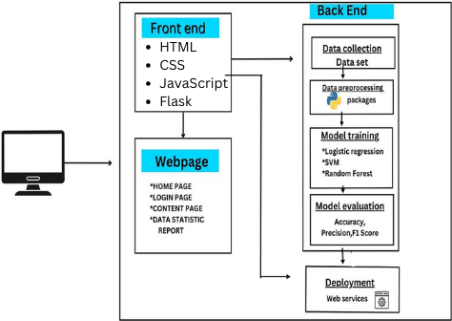
ARCHITECTURE DIAGRAM

Slide 13
METHODOLOGY
MODULE 1: Data collection & Feature extraction
Data Collection: Obtain a dataset with URLs categorized as phishing or legitimate for training and testing the models.(Kaggle & UC)
Feature extraction from URLs, commonly used Python packages include:
Pandas: For loading, managing, and analyzing datasets
Numpy: For numerical operations and data manipulation.
Requests: To fetch data from URLs if needed.
Re (Regular Expressions): For pattern matching in URLs.

Slide 14
MODULE 2: Data Preprocessing:
Clean and preprocess the extracted features to prepare them for model training. This may involve:
Handling missing values.
Encoding categorical variables.
Normalizing numerical features.
Scikit-Learn: Provides tools for encoding, normalization, and preprocessing tasks.
Numpy: For efficient numerical operations.
Pandas: For handling missing values and basic data manipulation.

Slide 15
MODULE 3: Model Training:
Train different machine learning models using the preprocessed dataset. Common models used for this task include:
Logistic Regression:
Regression is a method to find the relationship between two or more variables.
It is a statistical technique used for binary classification tasks, where the goal is to predict one of two outcomes (e.g., yes or no, spam or not spam).
SIGMOID FUNCTIONy = β0X0+ β1X1 + β2X2 + + βn*Xn
where:
“BO", "B1", "B2"... "ẞn" are the coefficients of the linear regression model.
"X1", "X2", ..., "Xn" are the input features

Slide 16
MODULE 4:Model Training:
Support Vector Machine (SVM):
A supervised learning algorithm used for classification and regression.
It finds the optimal hyperplane that separates data points of different classes by
maximizing the margin between them.
Py package - from sklearn.svm import SVC
Random Forest:
Random Forest is a popular machine learning algorithm that belongs to the supervised learning technique.
It can be used for both Classification and Regression problems in ML. It is based on the concept of ensemble learning,
which is a process of combining multiple classifiers to solve a complex problem and to improve the performance of the model.
The greater number of trees in the forest leads to higher accuracy and prevents the problem of overfitting.

Slide 17
MODULE 5: Model Training:
Why use Random Forest?
It takes less training time as compared to other algorithms.
It predicts output with high accuracy, even for the large dataset it runs efficiently.
It can also maintain accuracy when a large proportion of data is missing.
Use Case: Fraud detection, recommendation systems,
Py package - from sklearn.ensemble import RandomForestClassifier

Slide 18
MODULE 6: Model Evaluation & Model Selection:
Model Evaluation:
Use scikit-learn to calculate performance metrics such as
Accuracy,
Precision, Recall,
F1-Score for each trained model
Model Selection:
Compare the evaluation metrics across models and select the one with the highest overall performance.
eg: random forest

Slide 19
MODULE 7: Frontend Development
HTML/CSS/JavaScript:
These are the core web technologies, and their latest stable versions are used:
HTML: HTML5 (latest standard)
CSS: CSS3 (latest features like Flexbox, Grid, etc.)
JavaScript: ECMAScript 2022 (ES12), with new features like optional chaining, nullish coalescing, etc.
FLASK
Flask is 3.1.0. (latest stable version as of 2024)

Slide 20
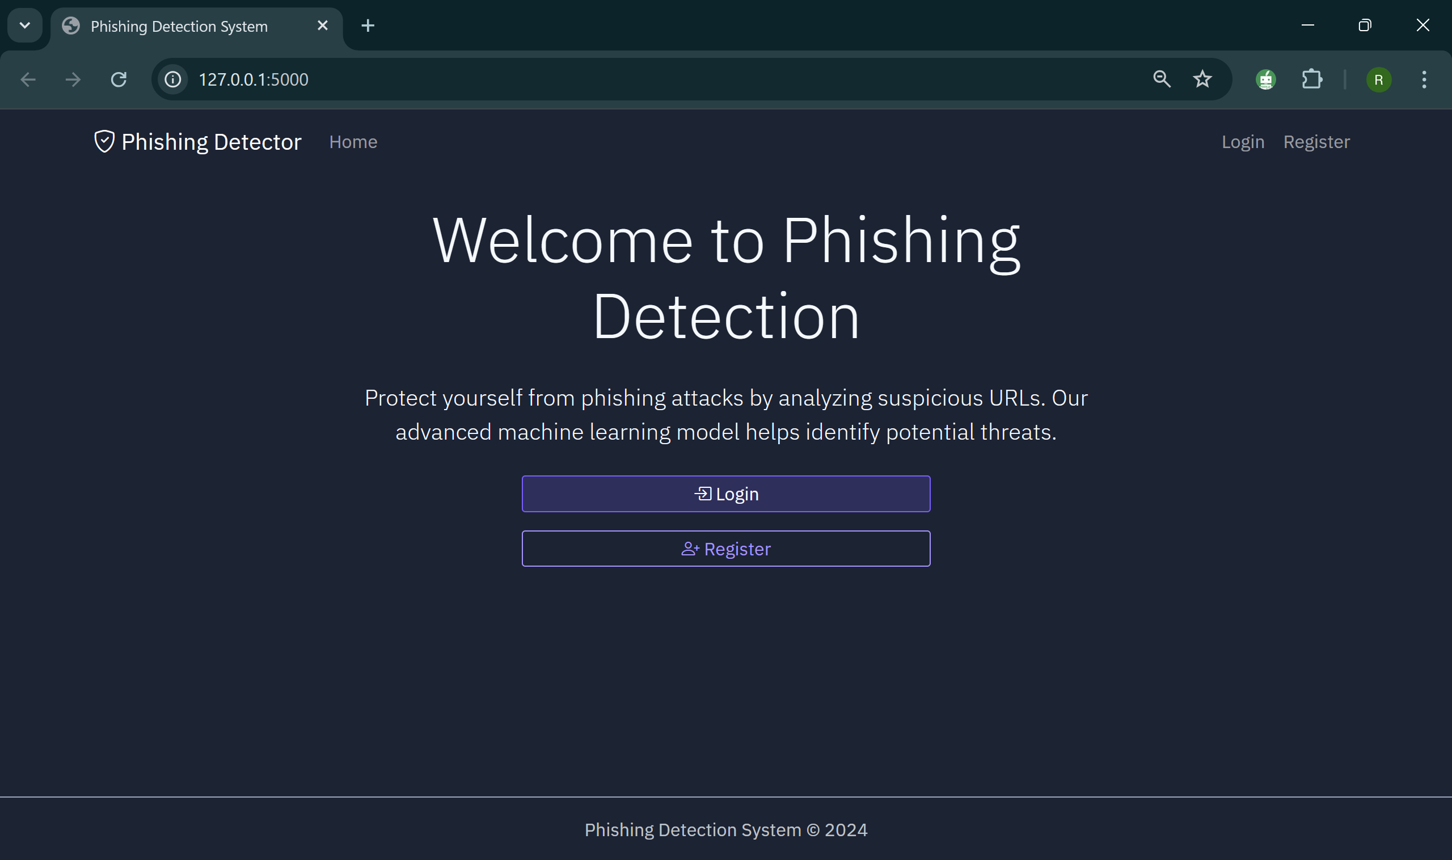
Project implementation: Home Page

Slide 21
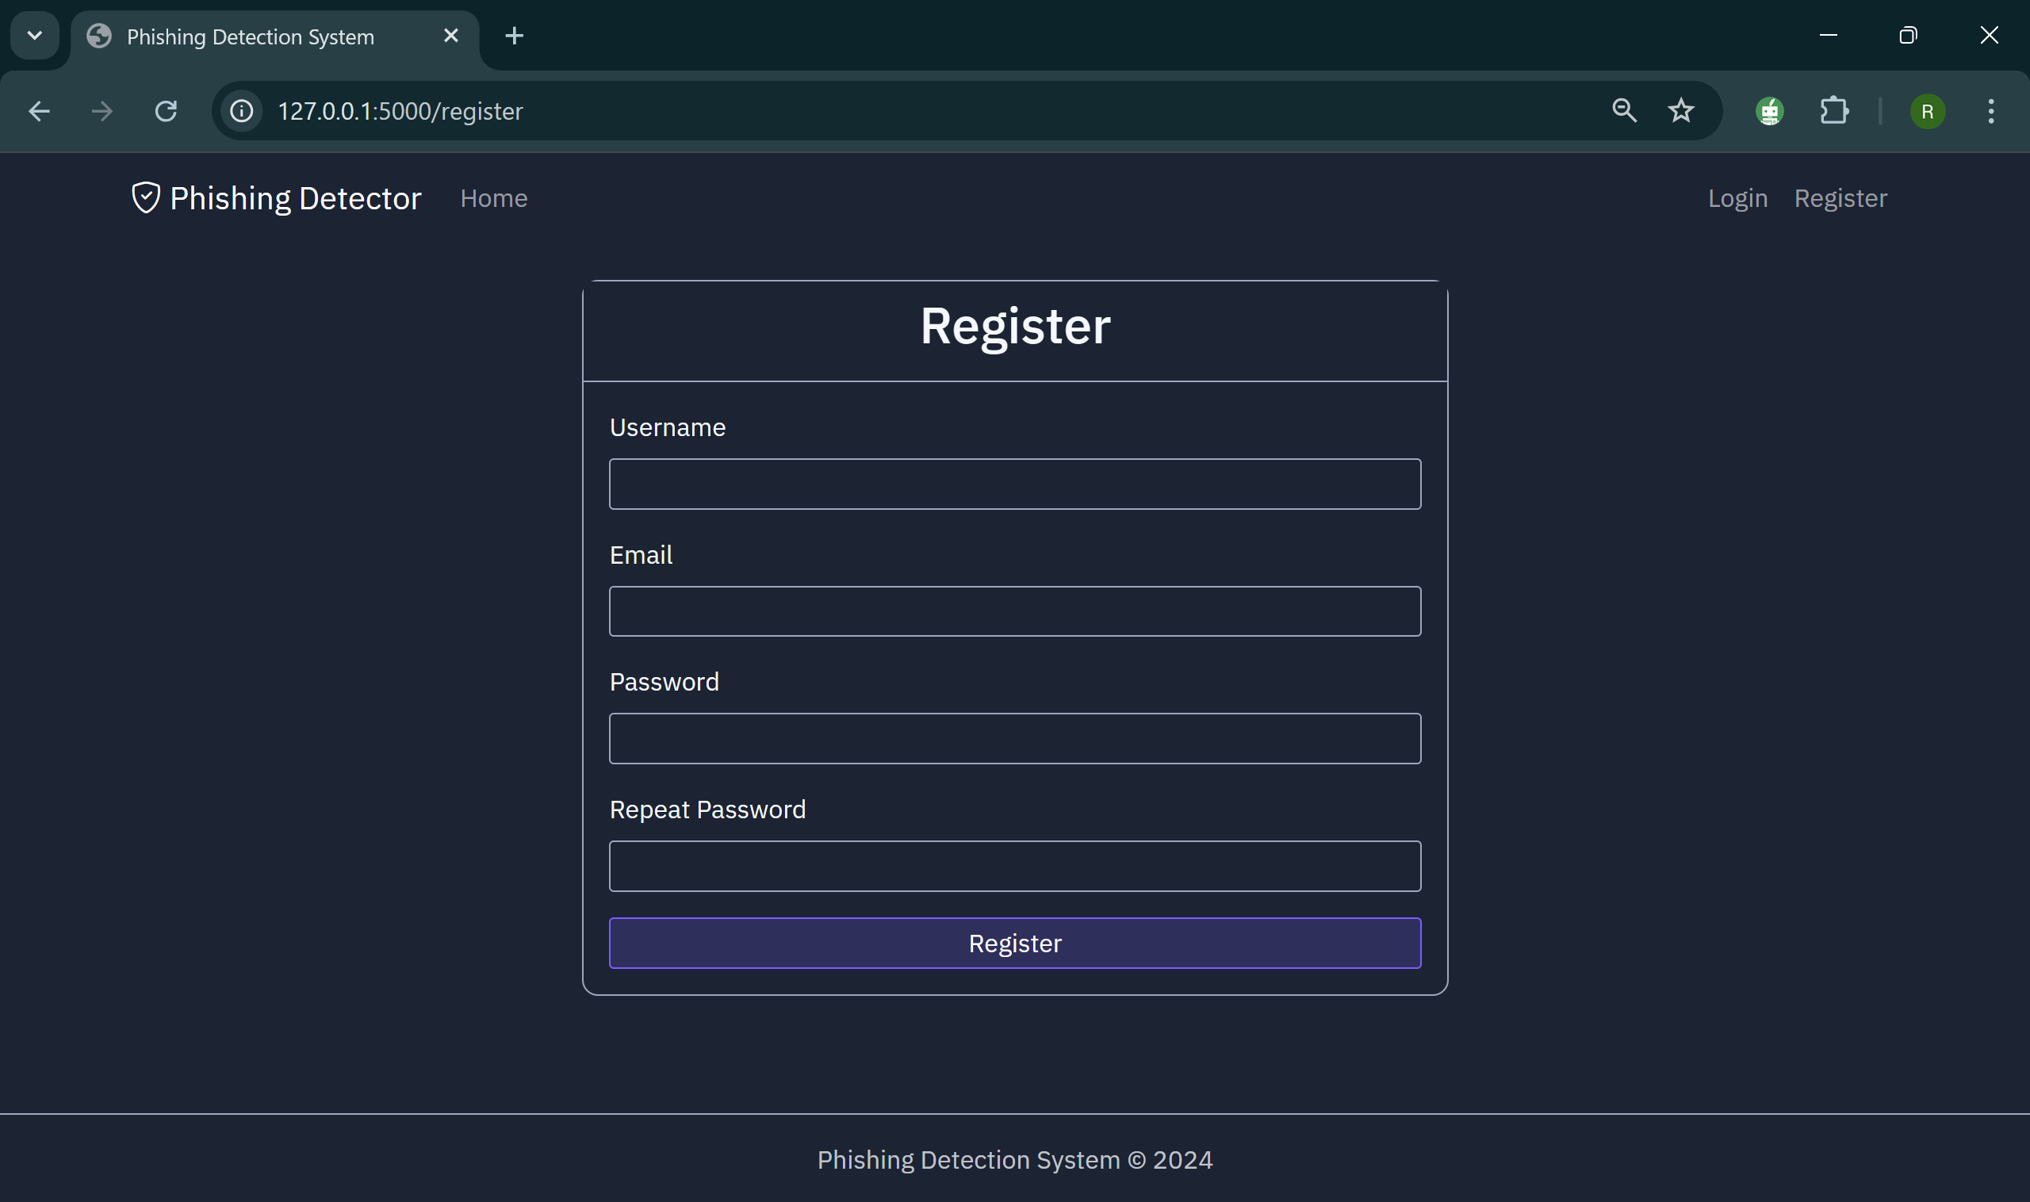
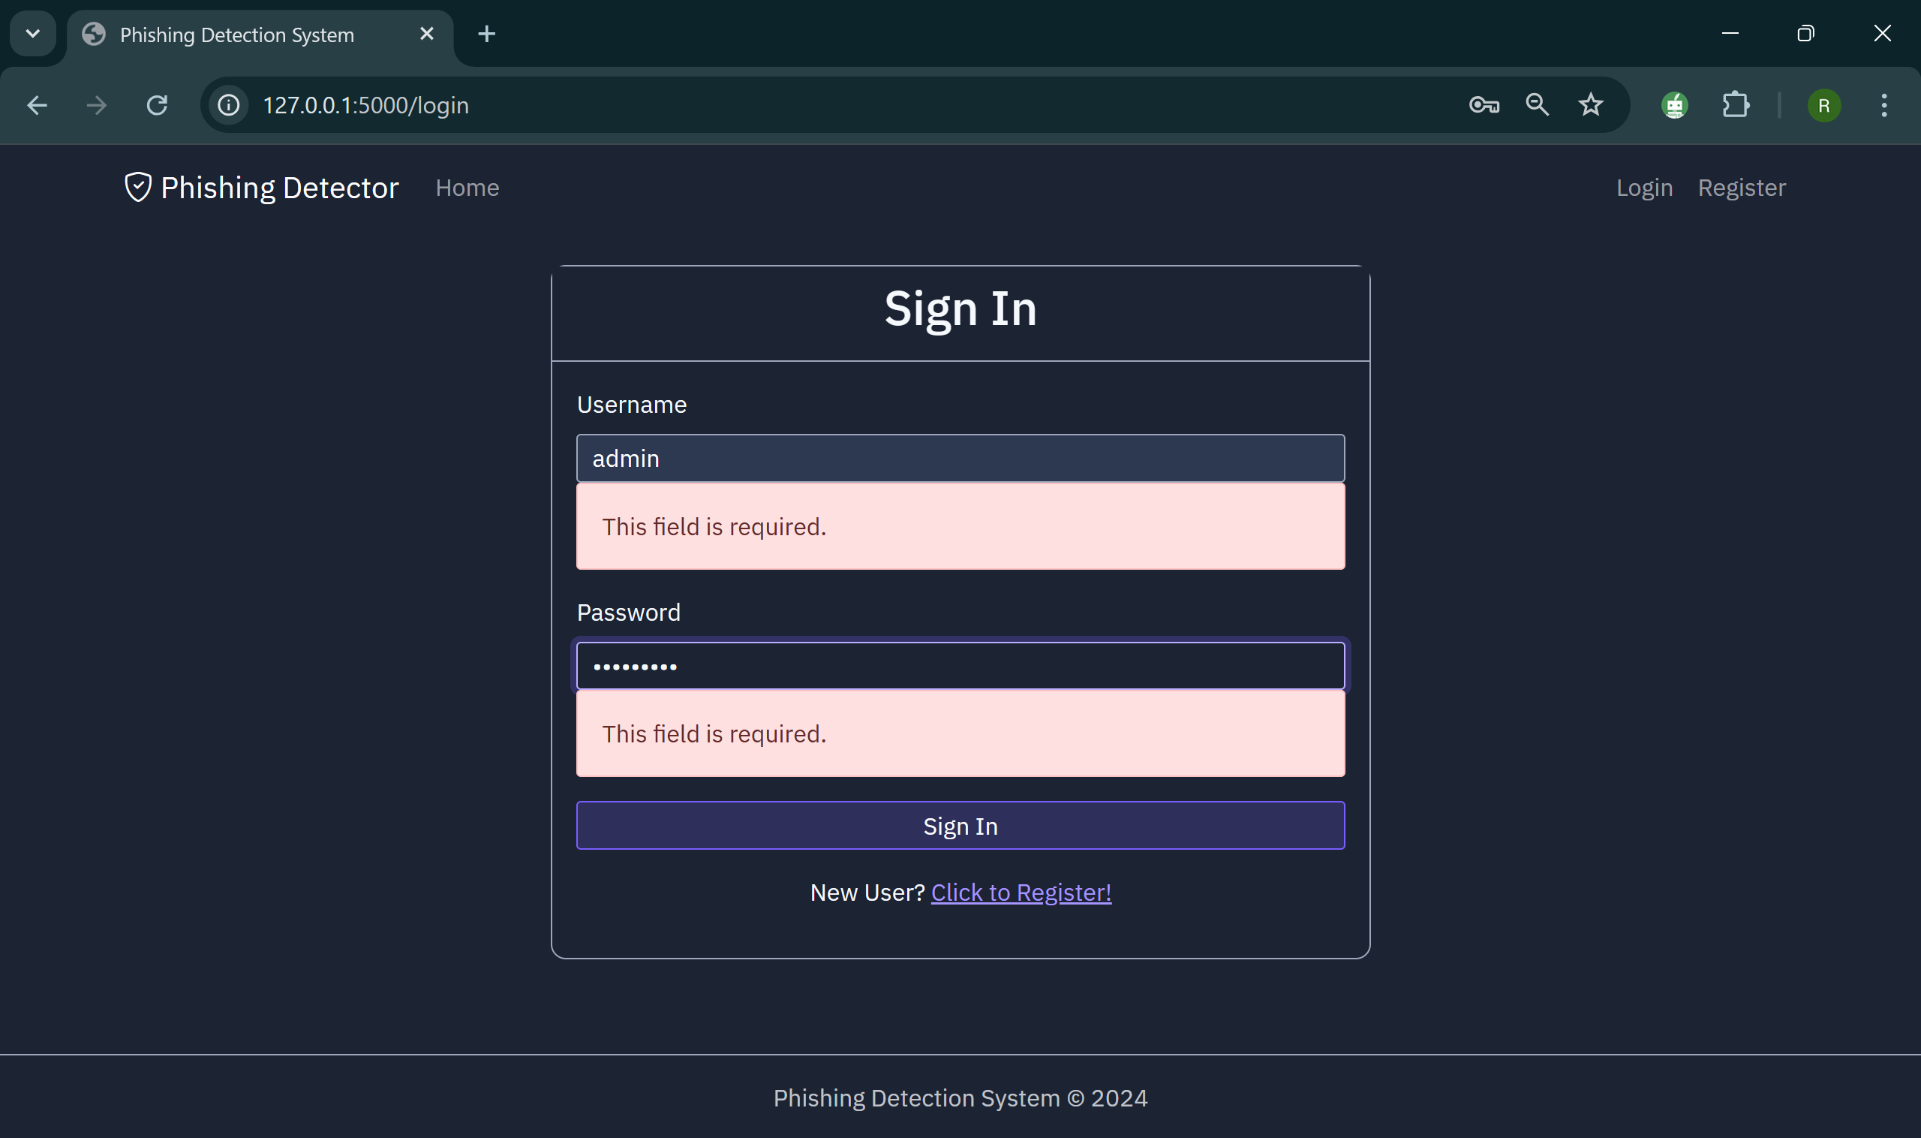
Project implementation- Front end Authentication

Slide 22
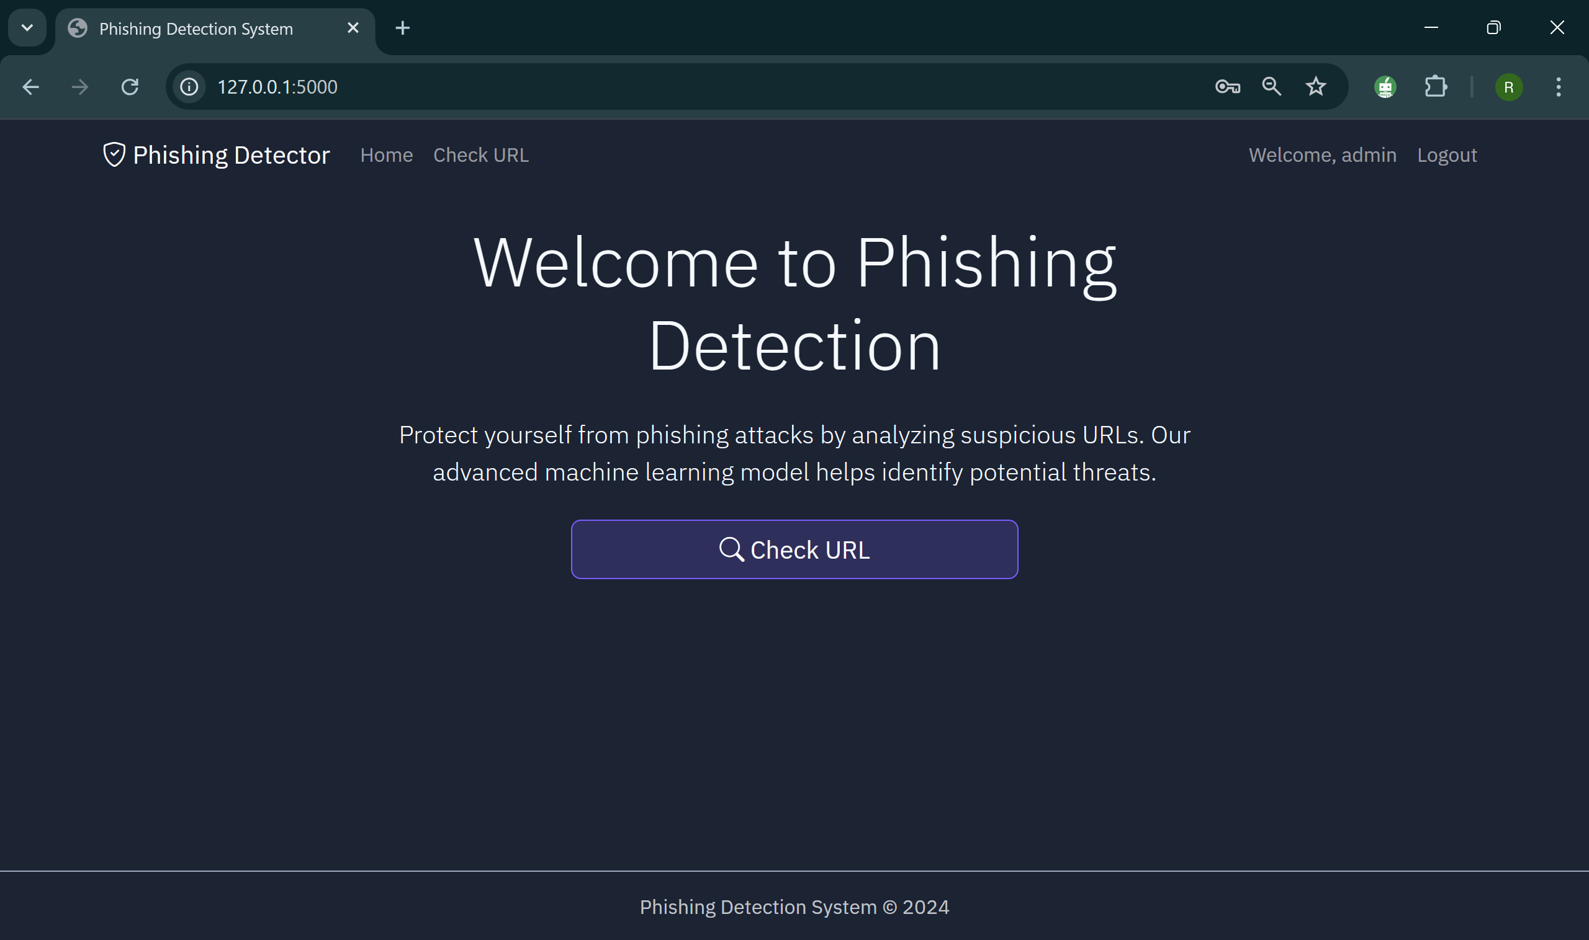
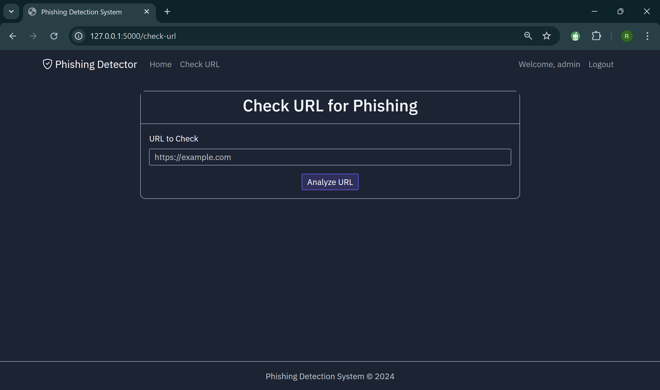
Project implementation-verified user and phishing detection

Slide 23
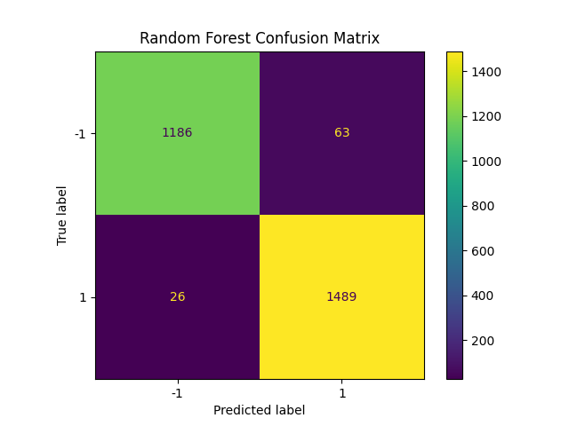
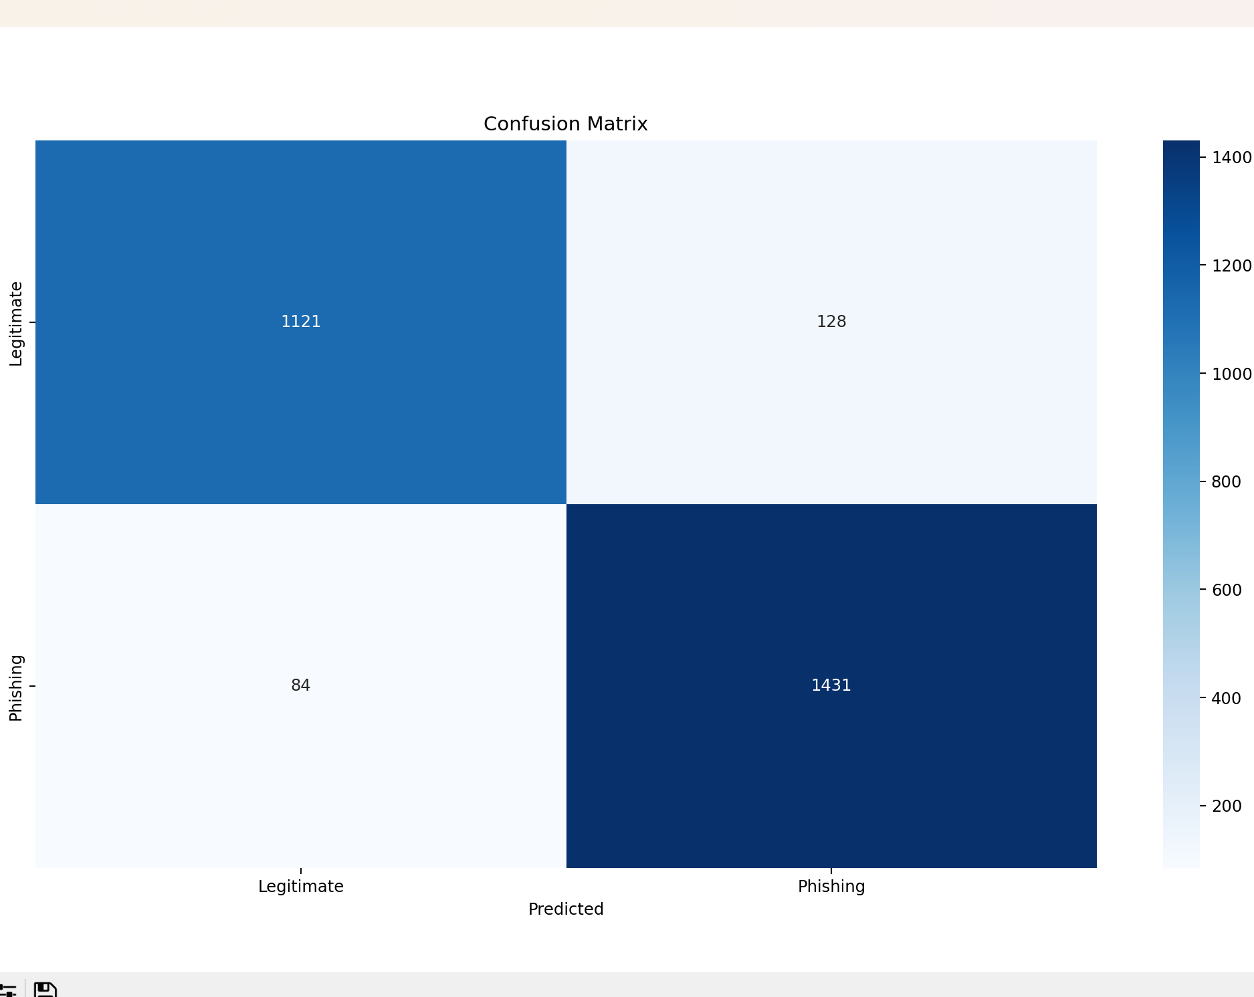
Project implementation-ML result

Slide 24
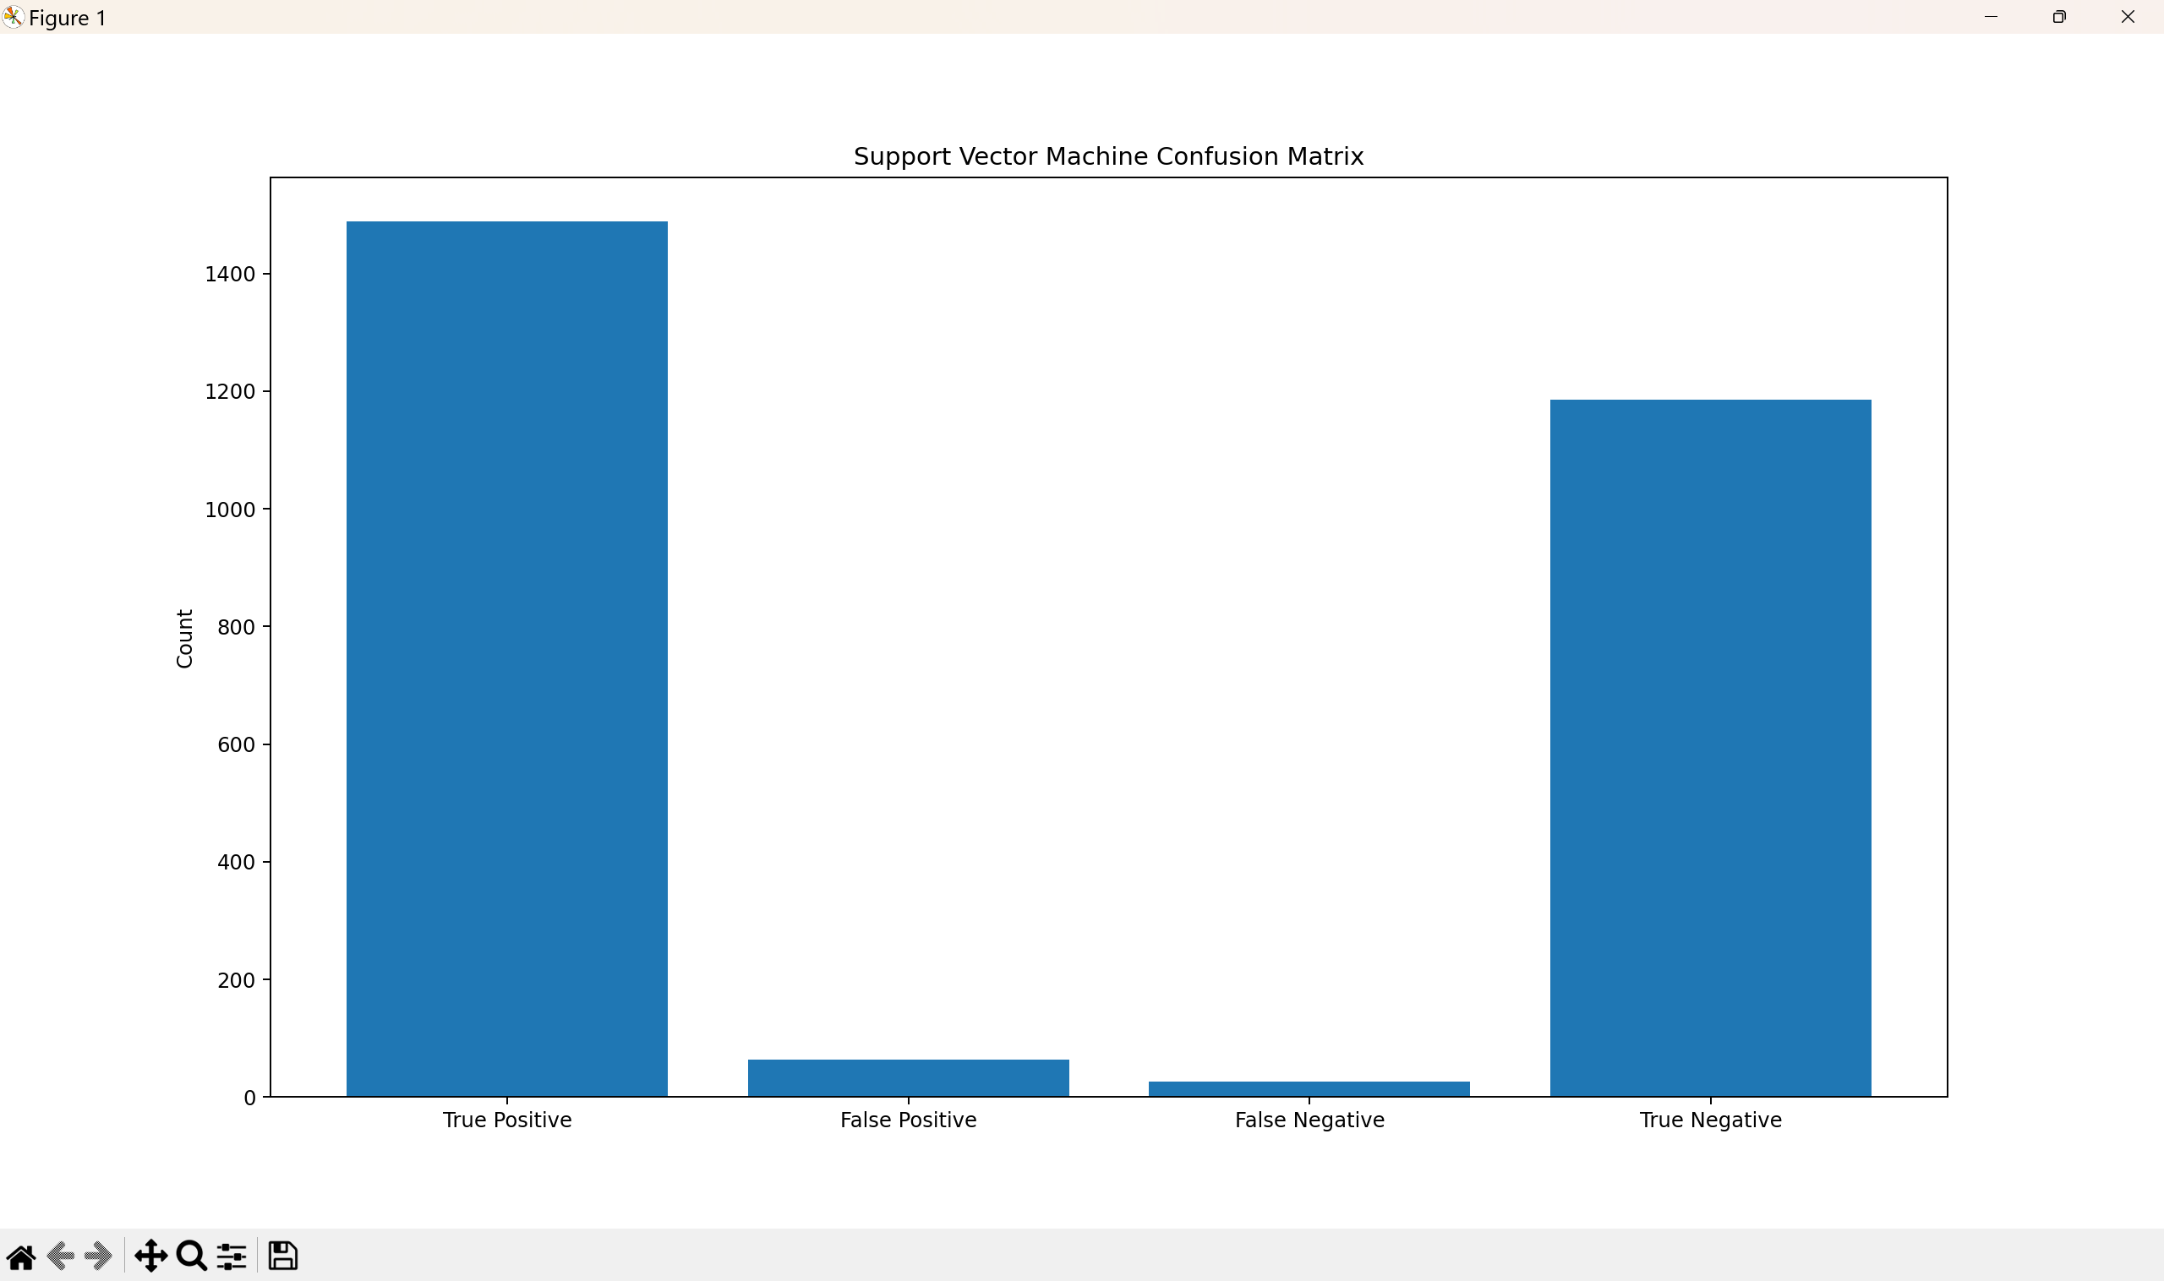
Project implementation-ML result

Slide 25
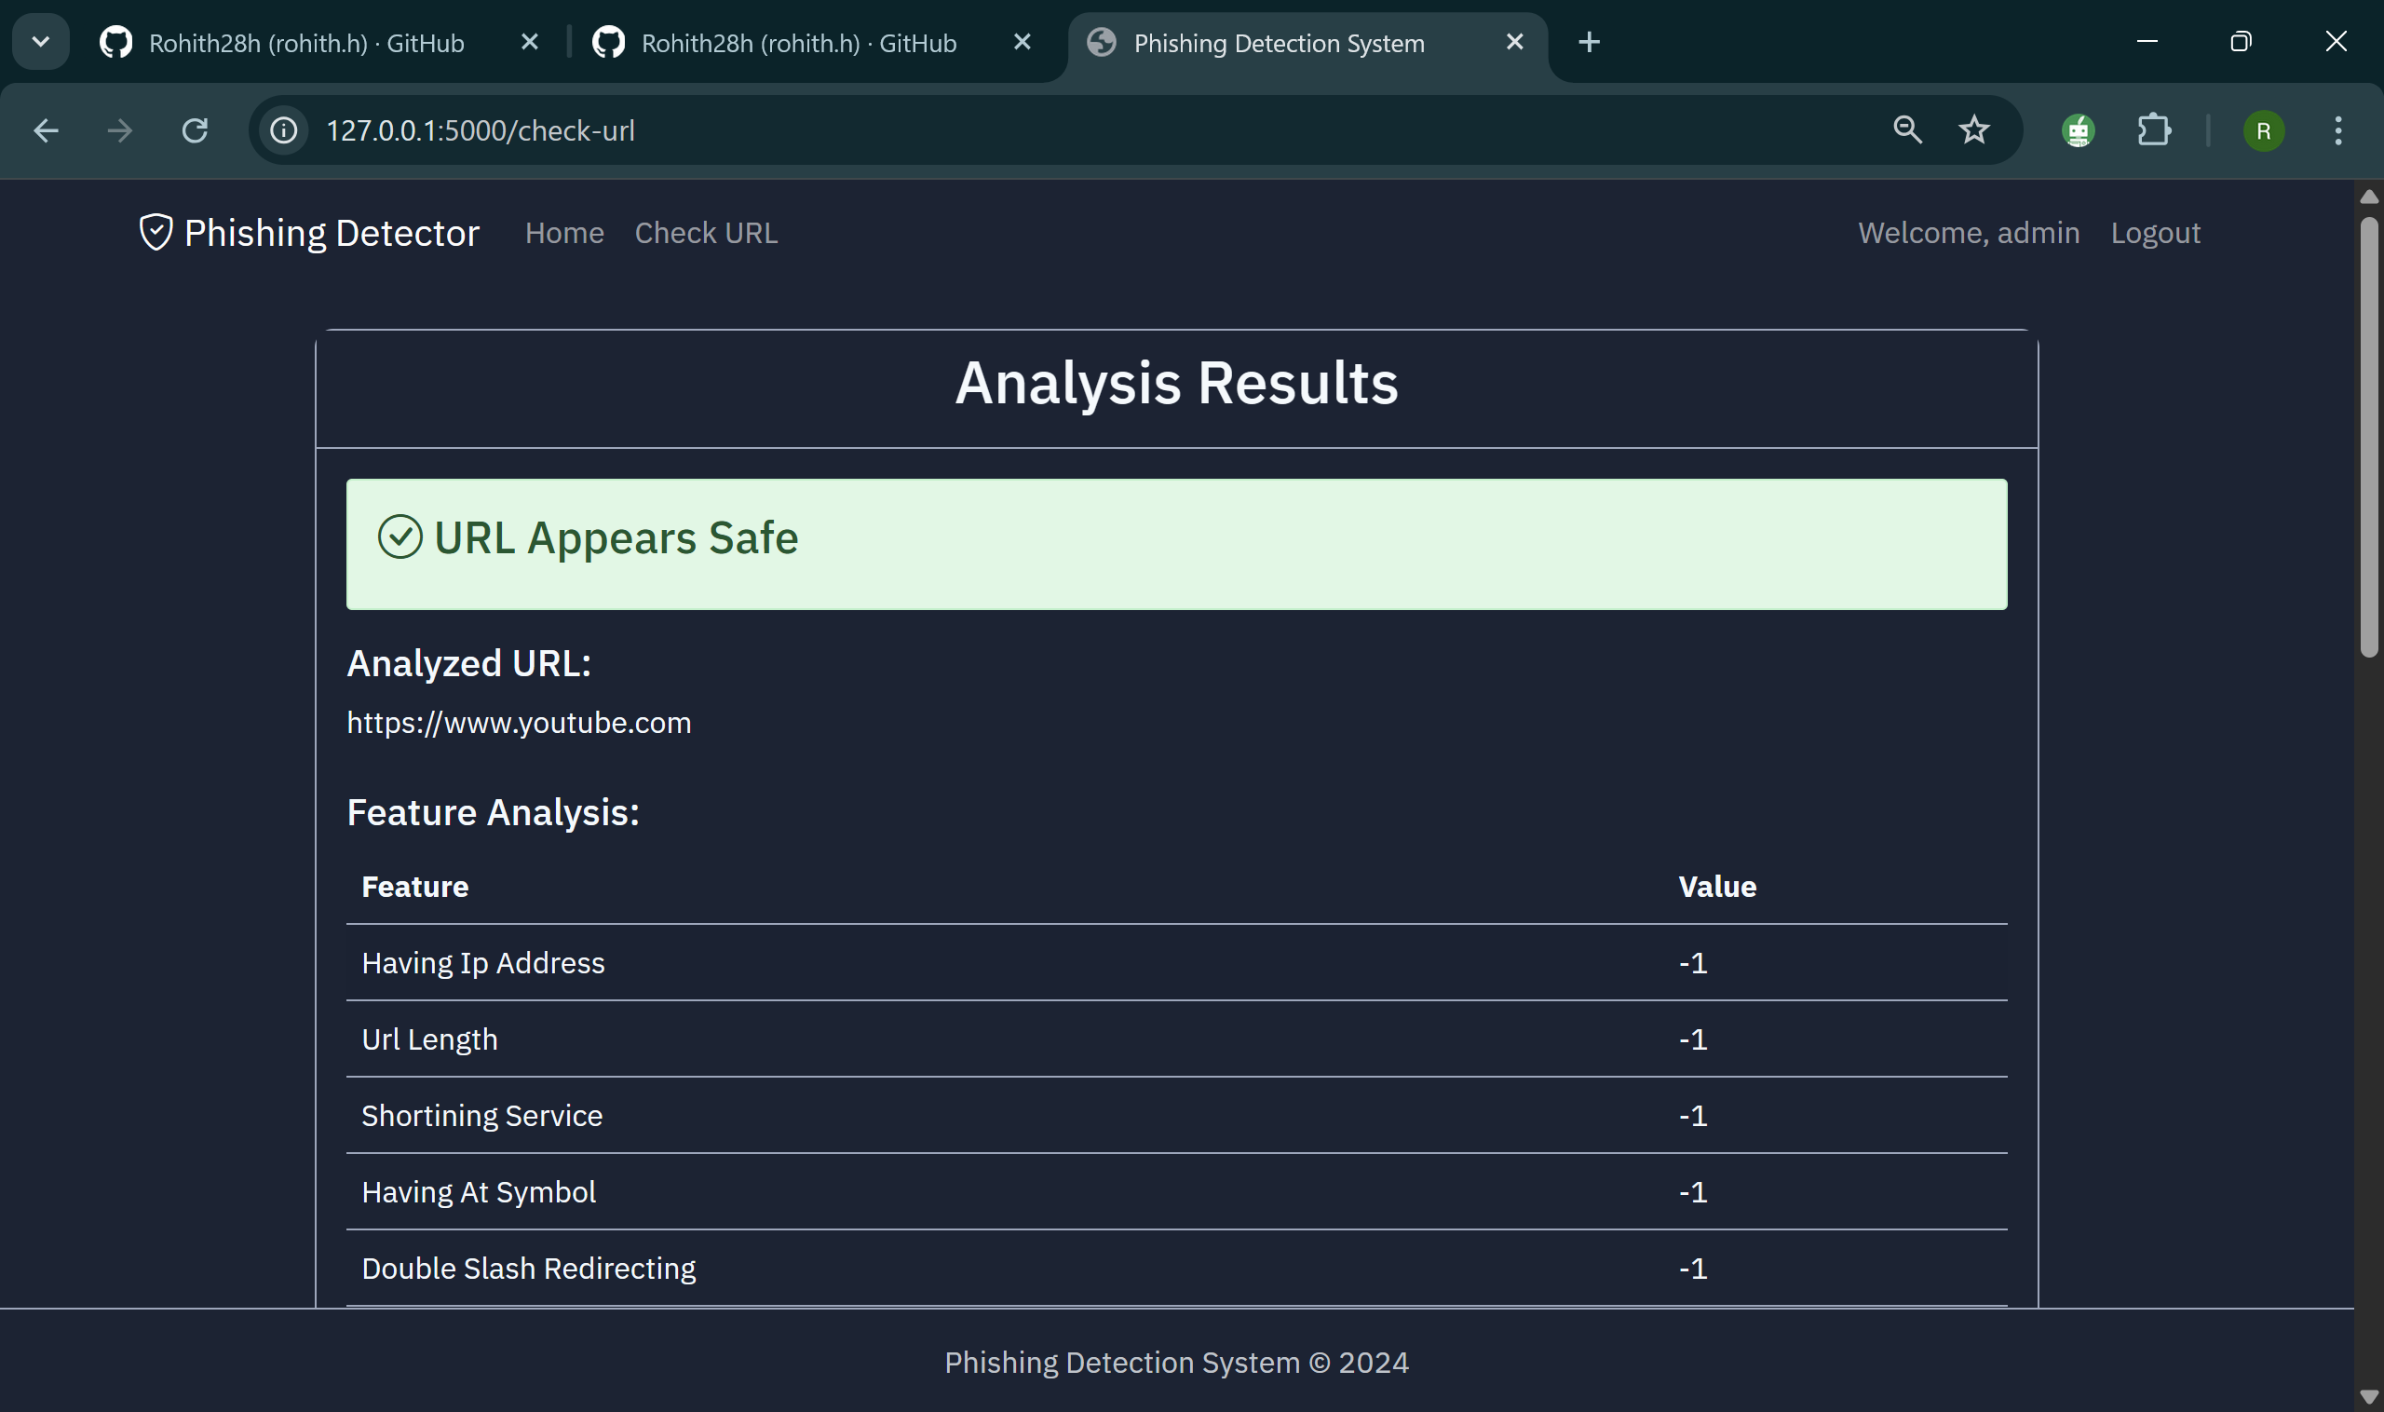
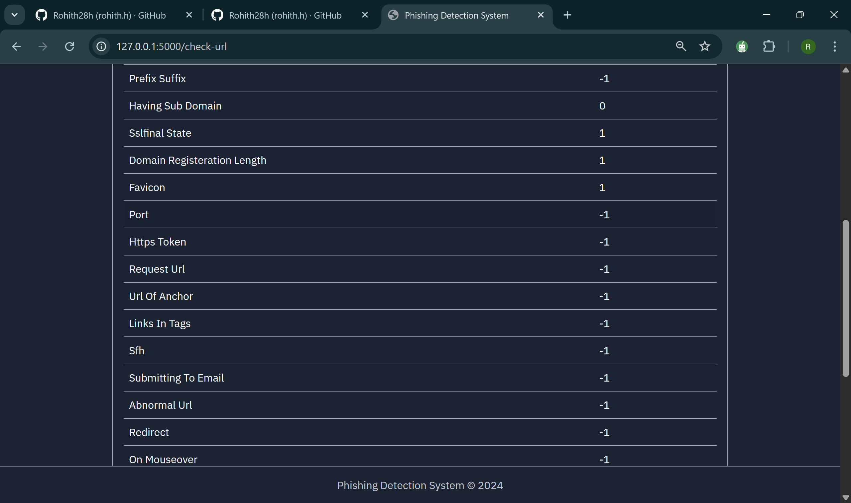
Project implementation-Detection Result

Slide 26
HARDWARE AND SOFTWARE REQUIREMENTS
HARDWARE REQUIREMENT
Laptop with required hardware
SOFTWARE REQUIREMENT
HTML: HTML5 (latest standard),CSS: CSS3 (latest features like Flexbox, Grid, etc.), JavaScript: ECMAScript 2022 (ES12), with new features like optional chaining, nullish coalescing, etc, Flask is 3.1.0. (latest stable version as of 2024) , Python 3.x is Python 3.13.2
Tools used: Visual Studio Code

Slide 27
REFERENCES
1. D. Rathee, and S. Mann 2022, Detection of E-mail phishing attacks–using machine learning and deep learning. International
Journal of Computer Applications, vol. 183, no 1, pp.1-7.
[2] E. Benavides-Astudillo, W. Fuertes, S. Sanchez-Gordon, D.Nuñez-Agurto, and G. Rodríguez-Galán 2023.
A Phishing-AttackDetection Model Using Natural Language Processing and Deep
Learning. Applied Sciences, vol. 13, no. 9, pp.1-23.
[3] U.A. Butt, R. Amin, H. Aldabbas, S. Mohan, Alouffi, and A.Ahmadian, 2023. Cloud-based email phishing attack using
machine and deep learning algorithms. Complex & Intelligent Systems, vol. 9, no. 3, pp.3043-3070.
[4] M.J. Nabet, and L. E. George, 2023. Phishing Attacks Detection by Using Support Vector Machine. Journal of Al-Qadisiyah for
Computer Science and Mathematics, vol. 15, no. 2, pp.180 .

Slide 28
REFERENCES CONTD.
G. Mohamed, J. Visumathi, M. Mahdal, J. Anand, and M. Elangovan 2022, An effective and secure mechanism for phishing
attacks using a machine learning approach. Processes, vol. 10, no. 7, pp.1-14.
[6] S. Hossain, D. Sarma, and R. J. Chakma 2020, Machine learningbased phishing attack detection. International Journal of Advanced
Computer Science and Applications, vol. 11, no. 9.pp.378-388.
[7] Y. Wang, W. Ma, H. Xu, Y. Liu, and P. Yin, 2023. A Lightweight Multi-View Learning Approach for Phishing Attack Detection
Using Transformer with Mixture of Experts. Applied Sciences, vol. 13, no. 13, pp.1-17.
[8] T. Choudhary, S. Mhapankar, R. Bhddha, A. Kharuk, and R. Patil, 2023. A Machine Learning Approach for Phishing Attack
Detection. Journal of Artificial Intelligence and Technology, vol.3, no. 3, pp. 108–113.

Slide 29
REFERENCES CONTD.
[11] A.T.G. Tapeh, and M. Z. Naser 2023, Artificial intelligence, machine learning, and deep learning in structural engineering: a scientometrics review of trends and best practices. Archives of
Computational Methodsin Engineering, vol. 30, no. 1, pp.115-159.
[12] F. Salahdine, Z. El Mrabet, and N. Kaabouch, 2021, December. Phishing Attacks Detection A Machine Learning-Based Approach. In 2021 IEEE 12th Annual Ubiquitous Computing, Electronics & Mobile Communication Conference (UEMCON) (pp. 0250-0255)IEEE

Slide 30
THANK YOU

